Slide 1

Dark web presentation
Dark web threatens human life
Dark Web Severity

Slide 2


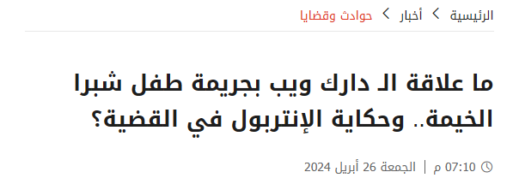
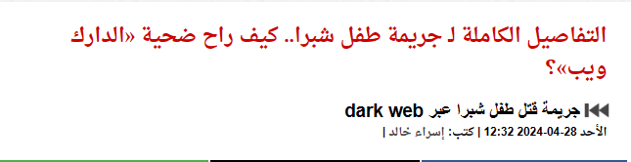
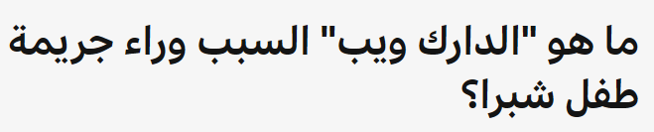
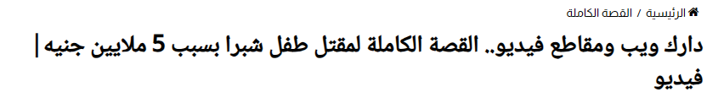
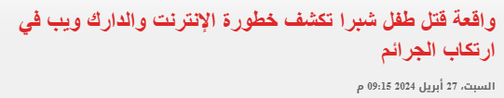

Slide 3

What is The Dark Web?
What does dark web mean and its definition?

Slide 4
What is the Dark web?

Slide 5




What is the Dark web?
The dark web refers to parts of the internet that are not indexed by traditional search engines like Google or Bing. It requires specific software, or authorization to access.
The Dark Web's anonymity attracts users seeking privacy, including journalists, activists, and those concerned about online surveillance.
Dark Web is the internet that intentionally hidden from search engines. It uses specialized software and protocols to mask user identities.
It can’t be accessed using a regular browser. Tools like Tor or I2P are needed.
Enhanced Privacy
Hidden Networks
Meaning
Accessibility

Slide 6
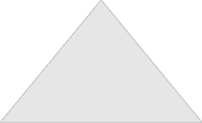
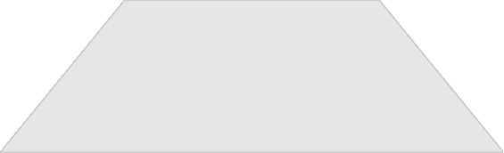
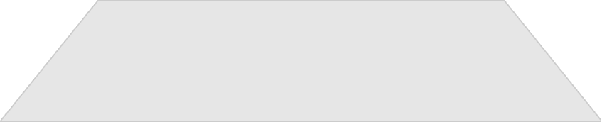
Web Layers
Surface Web
1
Accessible to everyone through standard search engines.
Deep Web
2
Protected content requiring logins or specific access.
Dark Web
3
Intentionally hidden, requiring specialized tools.

Slide 7
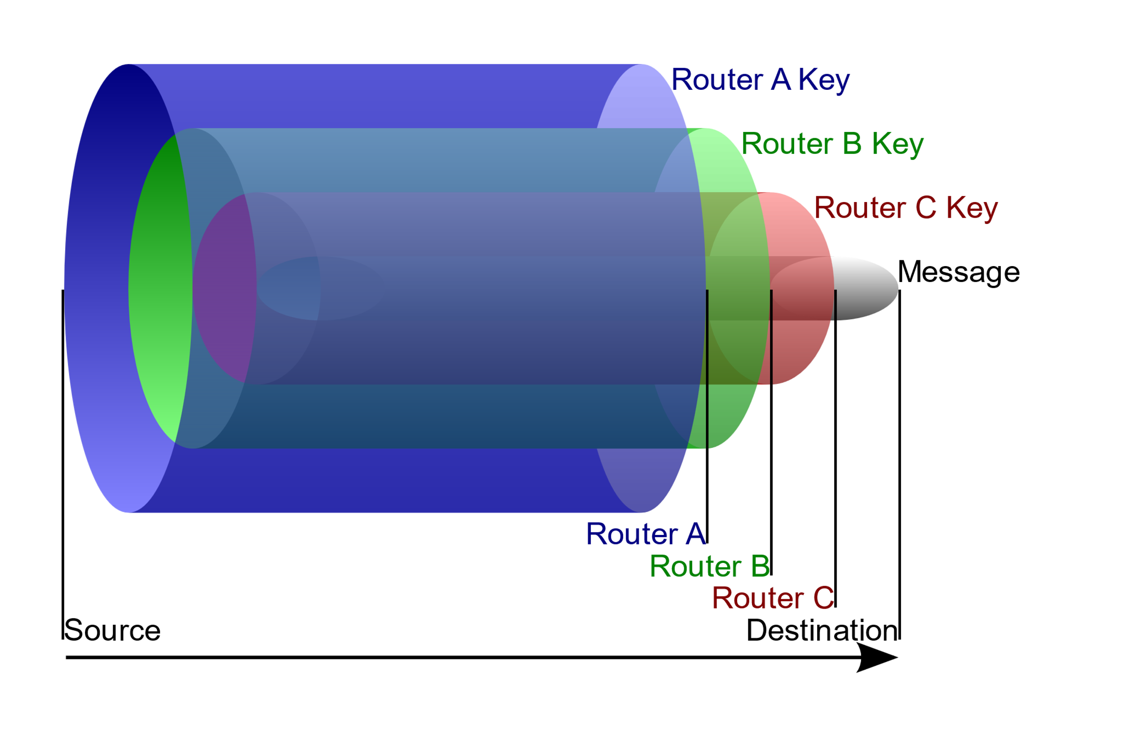
Dark Web System
How does the dark web work?
Download the Tor browser: Required to access sites with the ".onion" extension.
Connection formation: Tor creates a random series of nodes between the user and the requested service.
Data encryption: Data is divided and encrypted in layers (like an onion) to ensure privacy.
Node transmission: Data passes through several intermediate devices (nodes), where each node knows only the previous and next node, which hides the source and destination.
Browsing sites: Browsing is done using ".onion" addresses, which are not indexed by traditional search engines.

Slide 8
History of the Dark Web
-Development of ARPANET by the U.S. Department of Defense.
-Launch of the Tor project to enhance online privacy.
-Growth of illegal activities (e.g., drugs, weapons)
1960s
1990s
2002
2000-2010
2010-2020
2020-present
-Emergence of encryption protocols like SSL.
-Rise of black markets like Silk Road.
-Government monitoring efforts and market takedowns.

Slide 9

Legal uses of the Dark Web
Privacy Protection
Anonymous Browsing
Provides protection for identity and personal data while browsing in monitored environments.
Allows browsing the internet without leaving a digital footprint or being tracked.
Legal
Dark Web
Of the
uses
Secure Communication
Offers a way for journalists and activists to communicate confidentially in repressive countries.
Whistleblower Protection
Provides a secure platform for exposing corruption and legal violations without risking personal safety.

Slide 10

illegal uses of the Dark Web
Cybercrime
Fraud and Theft
Selling hacking tools and malicious software.
Trading stolen data such as credit card information.
illegal
Dark Web
Money Laundering
Crime Planning
Using cryptocurrencies to launder illicit money.
Planning and executing criminal activities like cyberattacks.
Of the
uses
Criminal Activities
Buying and selling illegal items like drugs, weapons, and stolen goods.
Illegal Content
Distributing prohibited content like child pornography or extreme violence.

Slide 11
statistics about crimes on the dark web
Crimes
300%
Statistics
Crimes
90%
Statistics
Crimes
56.8%
Statistics
Crimes
$1.2M
Statistics
Crimes
60%
Statistics
Activity on the dark web spiked by 300% between 2017 and 2020, driven by increasing use of cryptocurrency and expanding darknet markets. In 2020, darknet vendors earned over $384 million in Bitcoin, up from $240 million in 2019
The dark web hosts vast amounts of personal data for sale. In 2022, over 1.2 million payment card details were leaked
Approximately 90% of posts on dark web forums are made by buyers seeking to contact criminals or hackers to access specific resources or databases.
Around 56.8% of the content on the dark web is associated with illegal activities, such as drug trafficking, hacking, and identity theft.
The U.S. accounts for 60% of dark web weapon sales. Drug trafficking also remains prevalent, though it constitutes only 4% of dark web listings

Slide 12


Dark Web Danger to Children
exploitation
Discovering
“Interaction between children and technology”
“Dealing with hackers”

Slide 13

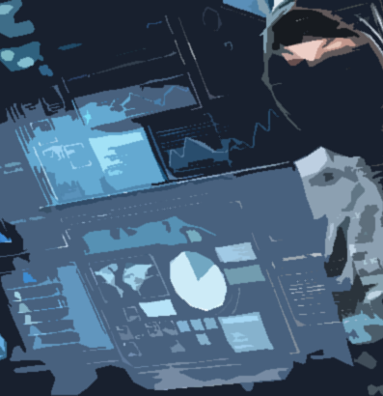
Famous dark web incidents
1. Silk Road (2013)
2. AlphaBay (2017)
3. Playpen (2015)
4. Red Room
5. Mt Gox Hack (2014)
6. Human Organ Trafficking

Slide 14


Law's role in mitigating dark web risks.
1. Legislative Updates.
2. International Regulation.
3. Monitoring and Analysis Technologies
4. Education and Awareness.

Slide 15
The Future of the dark web
Increased Law Enforcement Activity
As governments and agencies develop better tools to track activities, expect a rise in law enforcement operations targeting illegal dark web markets.
AI & Automation
Blockchain Integration
AI tools will enhance cybercrime detection and may even assist in automating illegal activities (like hacking), while also helping in better detection and prevention.
Cryptocurrencies like Bitcoin will continue to fuel transactions in the dark web, offering further privacy.
Privacy Enhancements
New encryption technologies and decentralized systems may provide stronger anonymity for users, driving adoption among privacy-focused individuals.

Slide 16

AWESOME
For Programmers
a. Privacy and Anonymity
b. Learning and Networking
c. Security Tools and Resources
For Journalists
a. Whistleblowing and Secure Communication
b. Access to Restricted Information

Slide 17
Take care of your children
How to Protect Yourself and Your Children from the Dangers of the Dark Web?
Educate Yourself and Your Children
Learn about the dark web and its dangers, such as illegal activities, harmful content, and potential scams.
-Talk openly with your children about internet safety and why certain areas of the web should be avoided.
Use Parental Controls
The dark web is a hidden part of the internet that can pose significant risks if not approached with caution. Here are steps to protect yourself and your children:
-Set up parental controls on devices and routers to restrict access to unsafe websites.
-Use filtering software to block potentially harmful content.
Monitor Online Activities
-Keep an eye on your children’s internet usage and the apps they use.
-Establish rules for screen time and appropriate online behavior.
Secure Your Devices
-Install antivirus software and ensure your devices are updated with the latest security patches.
-Use strong, unique passwords for all accounts and enable two-factor authentication.

Slide 18

The Internet Is Not a Safe Place
The internet can be a valuable resource, but it is not always a safe environment.

Slide 19
THANK YOU
The danger of the Dark Web

